Slide 1

NewsNova AI
AI-native news made simple for students

Slide 2
ET GEN AI HACKATHON
About Me
Simran Jaiswal, CSE (Data Science) student passionate about AI, development, and building real-world solutions.
About Nova AI
A smart news assistant that simplifies complex information into fast, student-friendly explanations.
Why I built this
Students struggle with dense news; I created NewsNova AI to make news simple, actionable, and a tool for faster learning.

Slide 3

Introduction
NewsNova AI delivers an AI-native news experience that helps students understand news, not just read it.
Quick, student-focused summaries and explanations turn long articles into actionable insights, saving time and improving learning. “News that thinks for you.”

Slide 4

01
Problem & Need

Slide 5
Complex articles
News articles are often long and technical, causing cognitive overload and wasted time for students.
NewsNova AI provides 2–3 line summaries and simplified explanations so users grasp the core quickly and move on to learning or action.

Slide 6
Student clarity
Students need clear, relatable explanations in simple language (Hinglish option available).
Our Explain feature converts complex reporting into student-friendly insights, boosting comprehension and study efficiency.

Slide 7

Lack personalization
Students face generic news feeds that overwhelm with irrelevant detail and no tailored learning path.
NewsNova AI delivers personalized explanations and concise summaries, matching reading level and interests to speed comprehension and retention.

Slide 8
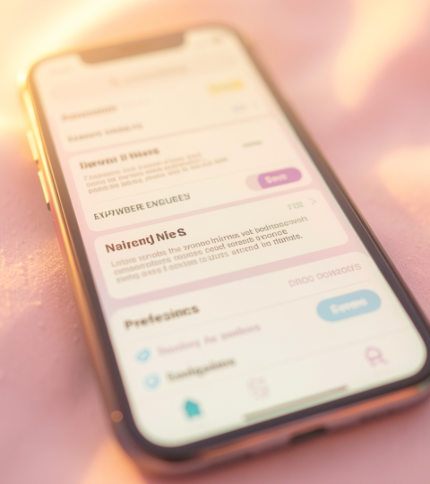
02
Solution & Features

Slide 9
AI explain
The Explain button converts dense reporting into clear, student-friendly language in 2–3 lines.
This feature offers contextual simplification, optional Hinglish, and immediate clarity to support faster learning and discussion.

Slide 10

Real-time news
Fetches up-to-date stories via News API for timely learning and classroom relevance.
Combined with smart filtering, users receive current, concise updates tailored to their preferences and study needs.

Slide 11
Future scope
Expand to voice explanations, multilingual support, personalized recommendations, and AI fact-checking.
These enhancements aim to make news accessible, trustworthy, and an active learning tool for every student.

Slide 12
Conclusions
NewsNova AI transforms overwhelming news into bite-sized, personalized learning moments that save time and boost understanding.
By combining real-time feeds with AI-driven simplification, this product empowers students to stay informed and engaged—news that thinks for you.

Slide 13


